Slide 1
Welcome!
Electrical Training Week 4

Slide 2
Announcements
11/8 & 11/17 - Soldering Training at The Hive
Be on the look out for an email with a soldering training sign up form!!!

Slide 3
Last Week
Communication Systems
EAGLE Schematics

Slide 4
This Week
Recap
Board Layout
Layers
Arranging components
Routing
Polygons
Commands
Lab!

Slide 5
Recap
Previously studied Parts/Libraries and Schematics
Libraries contain a device which has a symbol and footprint
In schematics, we use nets link pins on a symbol together to represent device function

Slide 6
Board Layout
Place and route

Slide 7
Board Layout
Physical placement of components on the PCB
Replace the abstract nets from schematic with physical traces
Access this feature by pressing the SCH/BRD button
Notes:
Pic of board layout

Slide 8
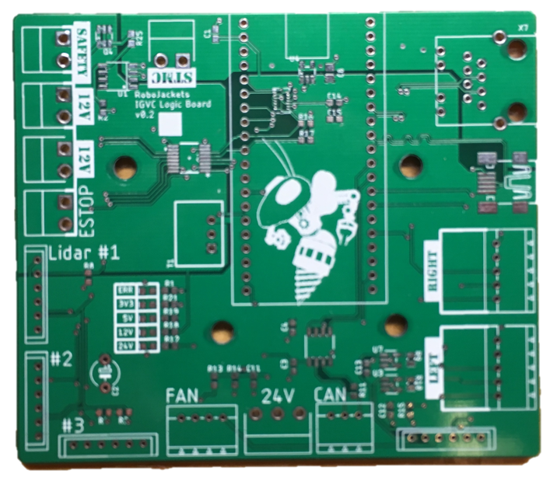
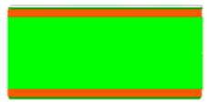
PCB Structure
Pads
Silkscreen
Soldermask
Copper
FR-4

Slide 9
Color | Layer Name | Layer Num | Layer Purpose
 | Top | 1 | Top layer of copper
 | Bottom | 16 | Bottom layer of copper
 | Pads | 17 | Through-hole pads (copper on top and bottom)
 | Vias | 18 | Vias to route signal between layers (copper on top and bottom)
 | Dimension | 20 | Outline of the board
 | tPlace | 21 | Silkscreen for top
 | bPlace | 22 | Silkscreen for bottom
 | tDocu | 51 | Top documentation layer (just for reference)

Slide 10
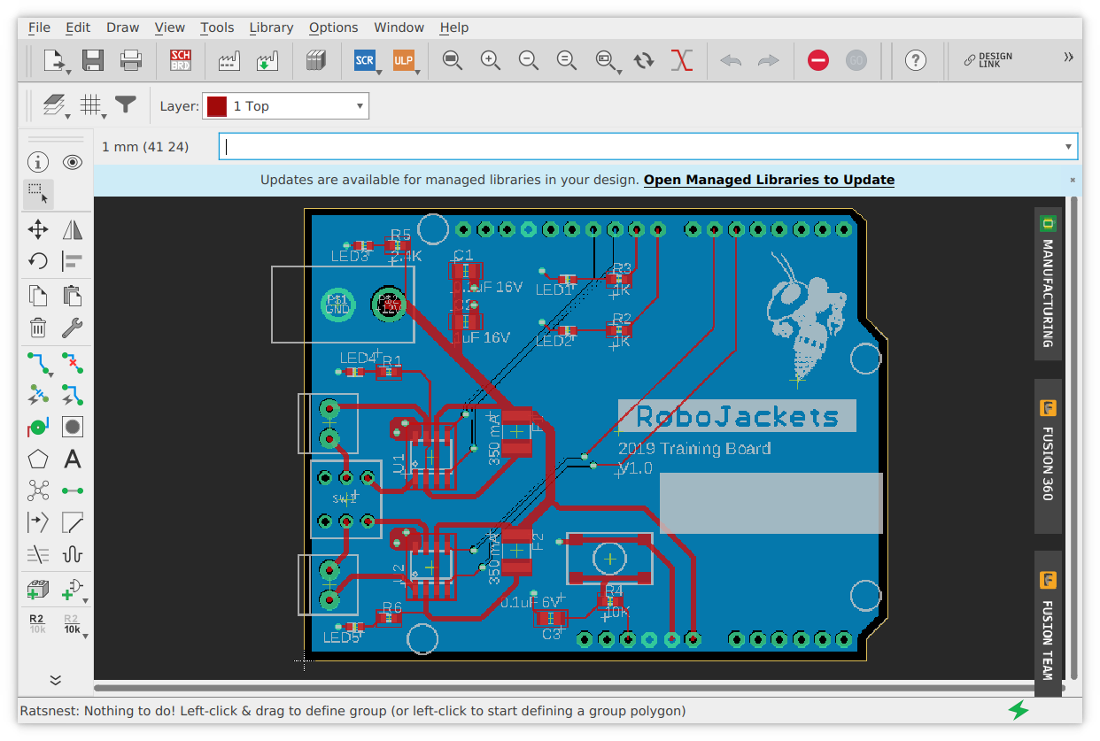
Changing Layers
Notes:
dropdown

Slide 11
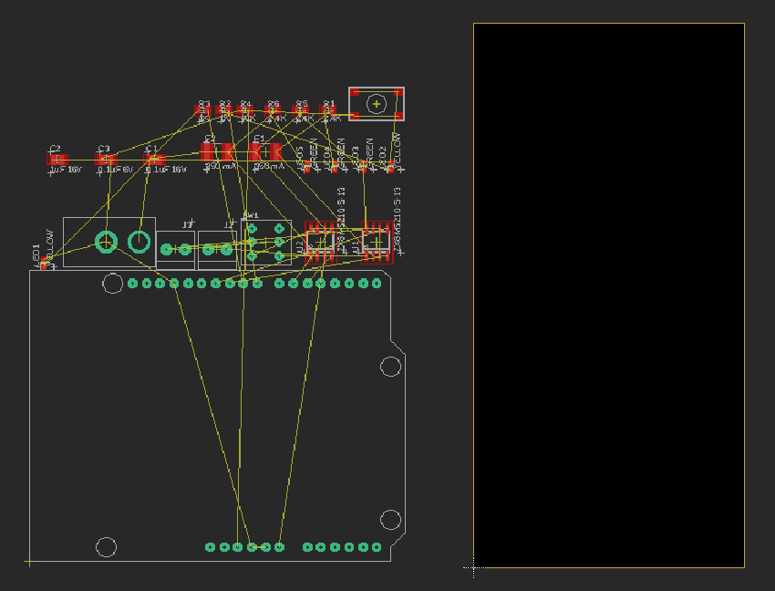
Board Generation

Slide 12
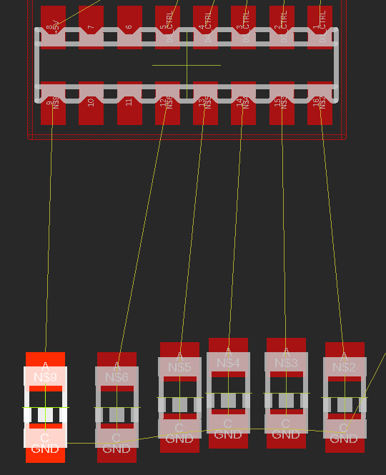
Arranging Components
Click on crosshair and drag to move parts around (or use command move)
Right click to rotate
Position components on the board area
Notes:
Explain airwires

Slide 13
Arrangement Considerations
Minimize airwires
Maximum size of board
Clearance between mounting holes and components
Location of specific components
Connectors on board edge
Decoupling capacitors near decoupled pins
Communicating/related components near one another

Slide 14
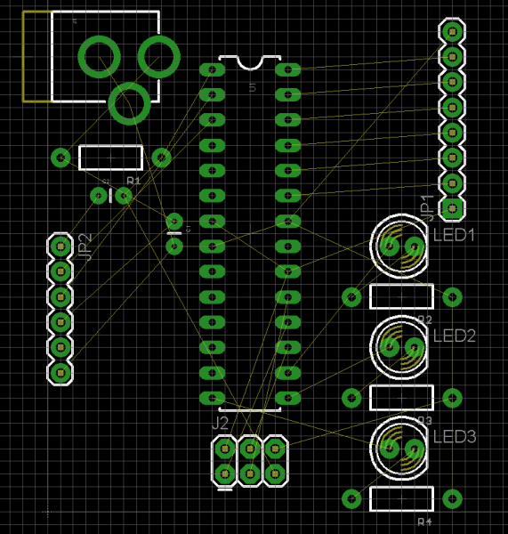
Arranging Components
Leave some space
Room for traces
Room to solder
Minimize the number of intersecting airwires
Easier to route traces
Notes:
Explain airwires

Slide 15
Drawing Traces
Use the route command
Left click on starting point and left click on end point
Follow start and end of airwire
Culture of 45 degrees

Slide 16
Changing Layers
Press “space” to change the layer and put a via
If your board has more than two copper layers you can press “space” again until finding the desired layer
You can also use the middle mouse button
Notes:
Inevitably, a portion of your circuit will get blocked off
You can route on the bottom layer of the board as well

Slide 17
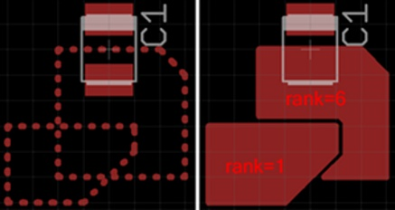
Polygons
Allows you to fill a drawn area with copper connected to a specific net
Useful to make “ground planes”
Draw polygon around area with polygon command and name with desired net
Running ratsnest will fill it
Notes:
Inevitably, a portion of your circuit will get blocked off
You can route on the bottom layer of the board as well

Slide 18
Design Rules and DRC
Design Rules
Predefined rules that your board layout should follow to be correctly manufactured.
DRC (Design Rules Checker)
This tool will check if your board layout is attending to all of the design rules and notify you accordingly.
Note: Load Design Rules early on your design.
Notes:
Explain why it’s a good idea to load early

Slide 19
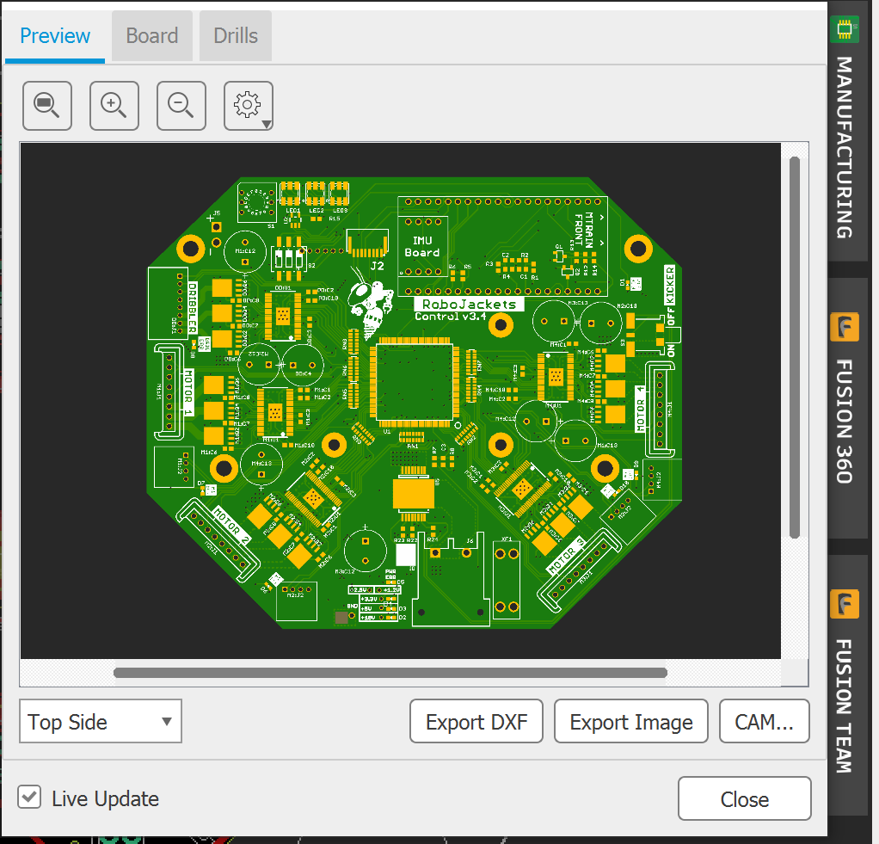
Manufacturing View
Preview
Make sure the silkscreen looks good (Both top and bottom side)
Board
Shows board properties: height, width, area, layers, board thickness, etc

Slide 20
Relevant Commands
ratsnest
Will update all the polygons and show them
Update airwires
ripup @ ;
This will hide the polygons on the board view
show @ <target_name> (example: show @ ENABLE)
Will highlight the objects with that target_name on your screen and draw an area around them
You can use * on the name for substituting every character (example: show @ EN* will highlight every object that begins with “EN”)
Notes:
Talk that you can: ripup <name>

Slide 21
Lab Summary
Start a new board layout
Set up the dimensions
Arrange the components
Connect the traces
Touch-up the silkscreen
Check your design with DRC
For more information, access the LAB Document on GitHub.

Slide 22
Resources
Eagle Training Guide:
https://github.com/RoboJackets/electrical-training/tree/master/references/eagle_training_guide
Eagle Style Guide:
https://wiki.robojackets.org/EAGLE_Style_Guide
How to branch on GIT: https://github.com/RoboJackets/robocup-firmware/blob/master/doc/Git.md

